Slide 1
Warm Chorus
S-89.3540 Audio Signal Processing
Aku Rouhe and Niklas Sallinen
27.02.2015

Slide 2
Content
Motivation
Generic Chorus
Orchestral Section Modeling
Warm Chorus
Structure
Harmonizer
Other Processing Steps
Results
Conclusion

Slide 3
Motivation
Chorus is used to get a bigger sound
As if played by a whole section
For R. Dudas:
A quartet performance of Haydn’s Seven Last Words, Op.51.
An allusion to orchestral and choral versions of the piece

Slide 4

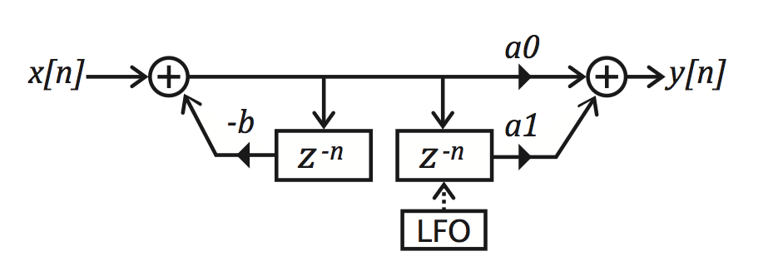
Generic Chorus
Simple algorithm using modulated delay lines
Unnatural, mechanical, and cheesy sound
Dry
Effected

Slide 5
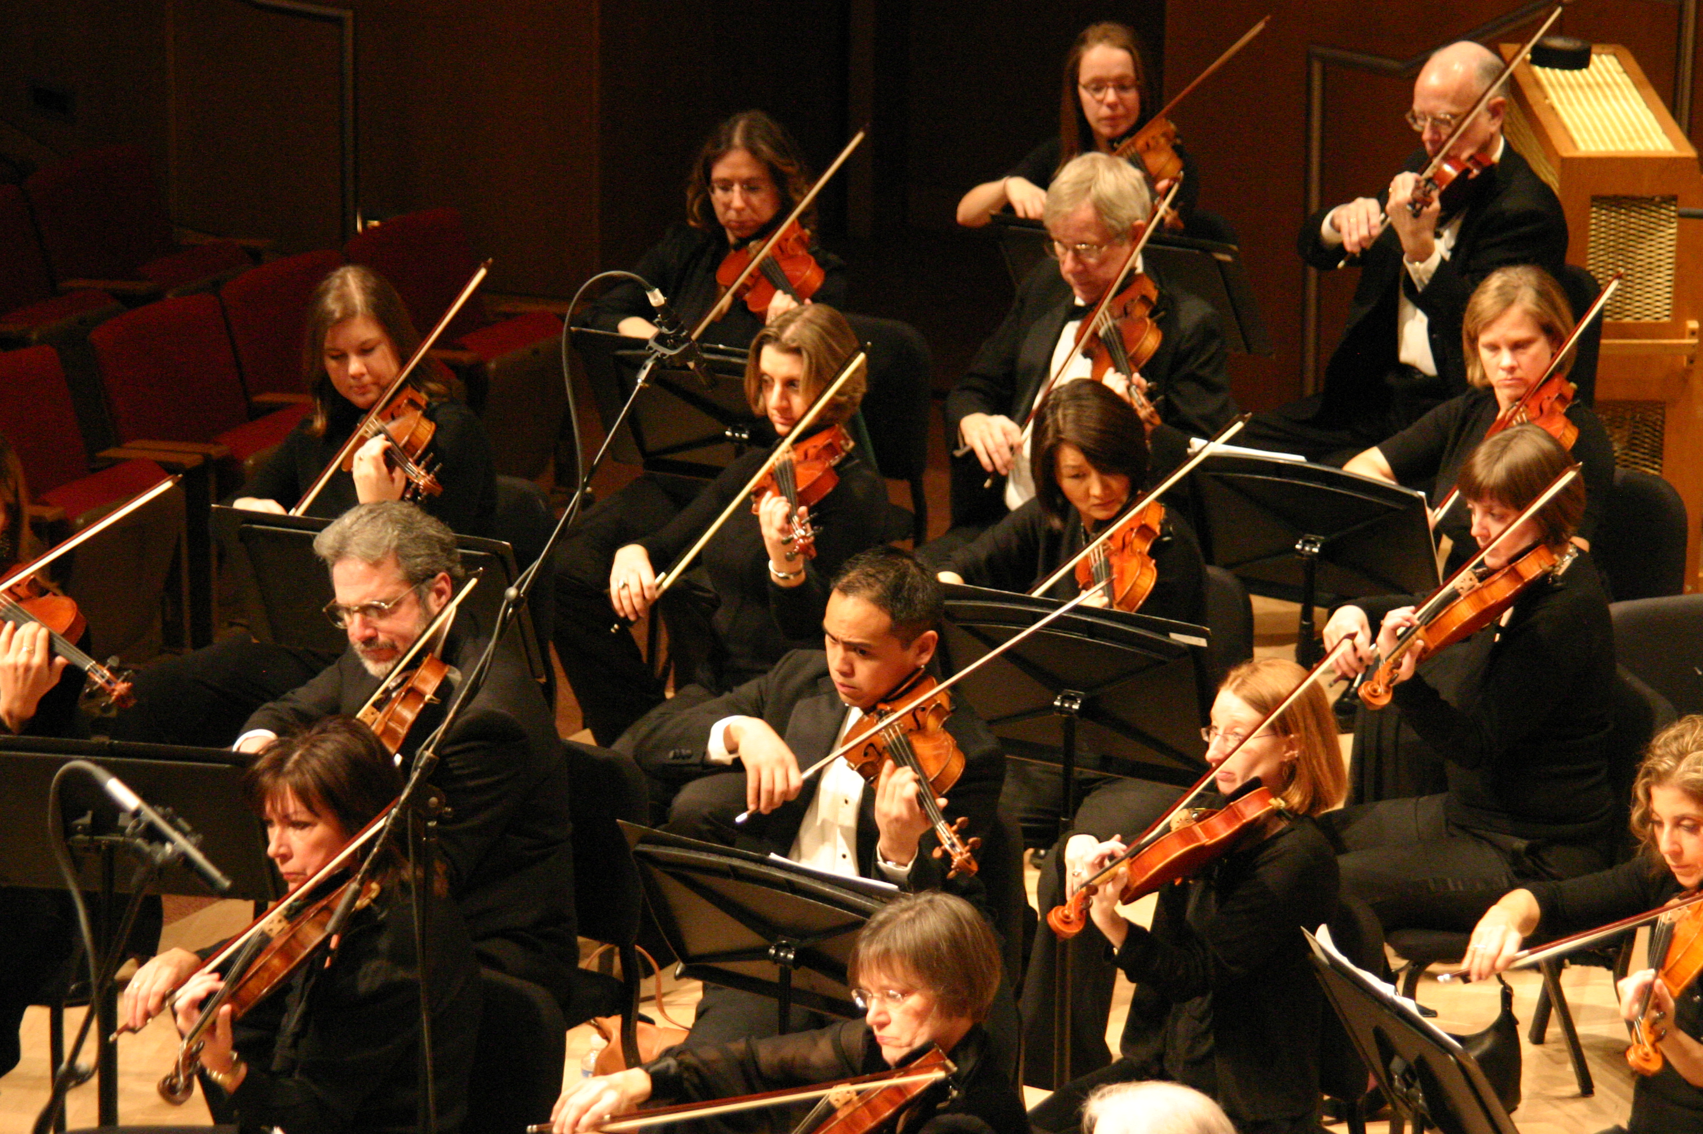
Orchestral Section Modeling
Based on human inspired model
Parameters from the placement and the skill of the players
http://www.evanstonsymphony.org/sites/default/files/node_gallery/Violin%20Section.jpg

Slide 6
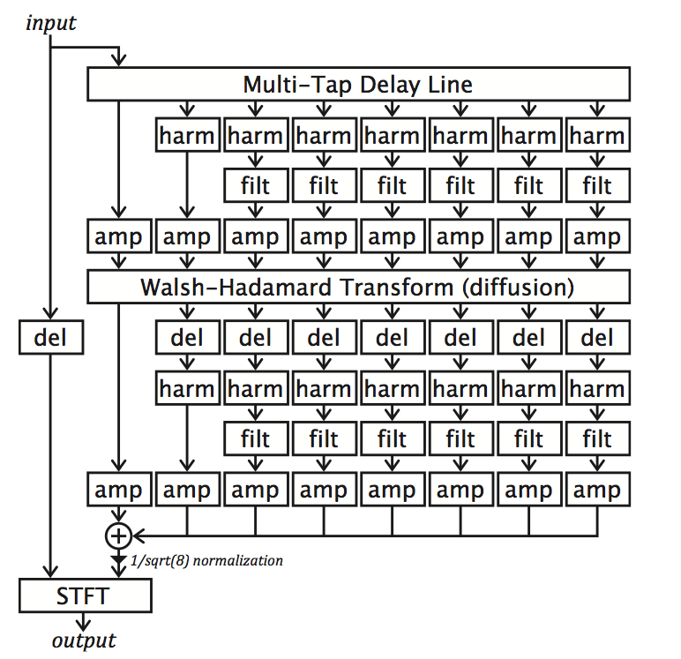
Structure

Slide 7
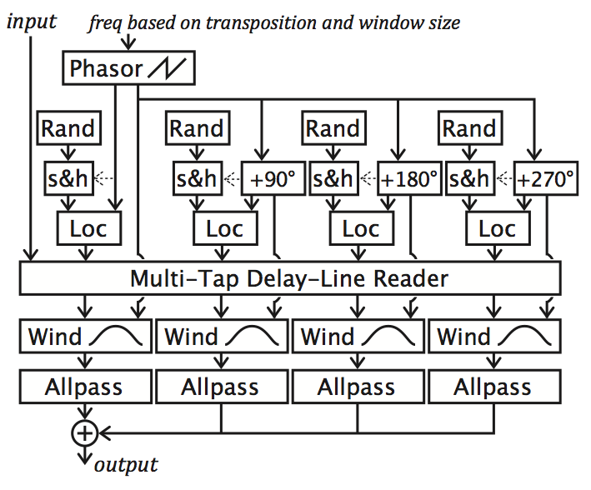
Harmonizer
Dry
Effected

Slide 8
Other Processing Steps
Delay based on distances of players
Filtering to model air absorption
Random amplitude ramping
Hadamard-matrix for diffusion
Frequency domain processing

Slide 9
Results
 | Violin | Guitar Lead | Guitar Chords | Music
Dry
Basic
Warm
Bad orchestra:

Slide 10
Conclusion
Chorus based on orchestral section modeling
Sounds like multiple players
No periodic behavior
Motivated by art, not by signal processing
Parametrised in real-world terms

Slide 11
References
[1] Dudas, Richard “Warm Chorus”: Re-thinking The Chorus Effect Using An Orchestral Section Model, Proceedings of the International Computer Music Conference (ICMC), Ljubljana, Slovenia, 2012, pp. 84-87

